Slide 1
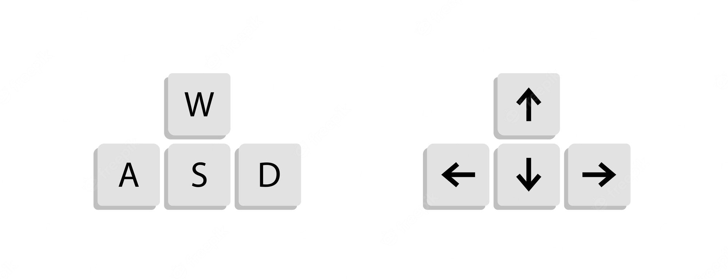

Forward
Up
Counter-clockwise
Clockwise
Left
Right
Down
Backward
P
TAKE PHOTO
TAKE VIDEO
SET NEW FACE RECOGNITION TARGET
V
T

